Slide 1


Design of multi-tier Internet applications SPEC: Web technologies engineering
REACT
INTRODUCTION
Present by Zhe Chen
64317 Group8

Slide 2


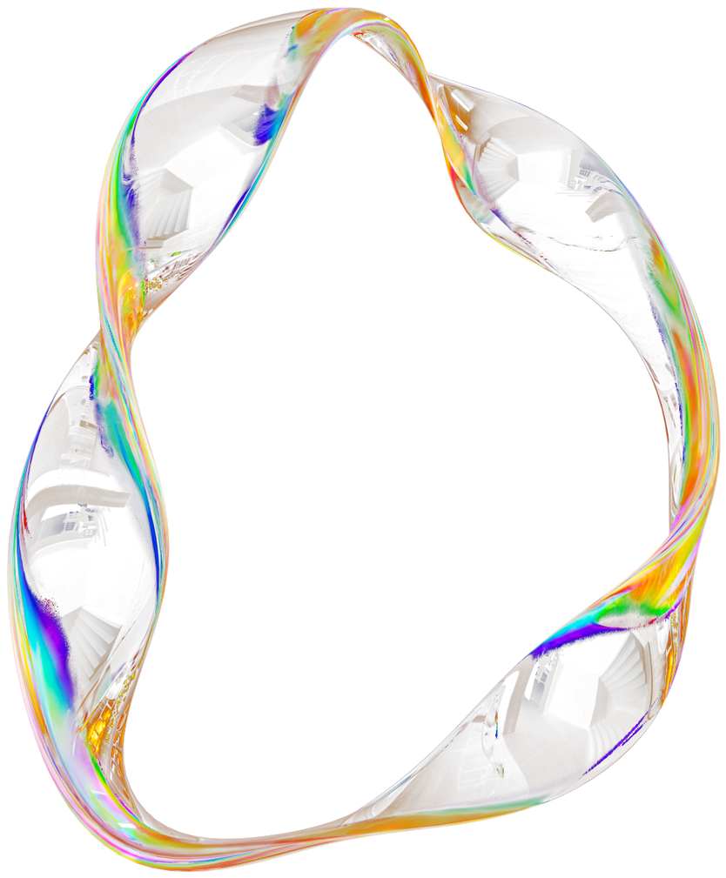
TODAY'S AGENDA
1
Introduction
6
Setting Up React
2
History of front-end JS framework
7
React Props and State
3
Fundamentals of React
8
React Hooks
4
JSX
9
Virtual DOM
5
React Components
10
Conclusion

Slide 3



WHAT IS REACT?
• React is a JavaScript framework
• Used for front end web development
• Think of jQuery, but more structured
• Created and used by Facebook
• Famous for implementing a virtual dom

Slide 4
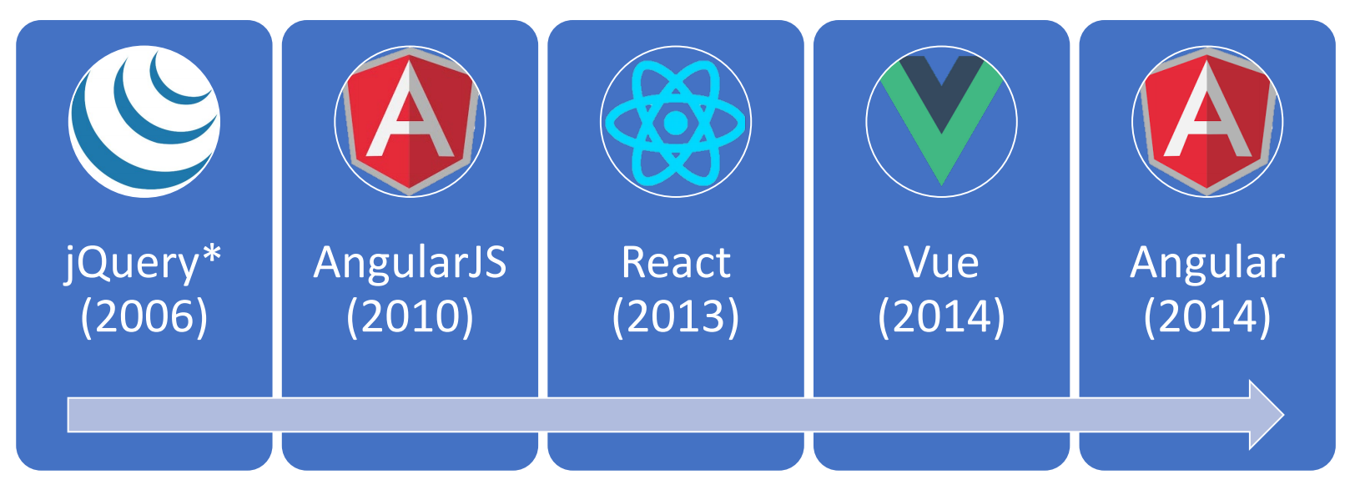
TIMELINE OF FRONT-END JAVASCRIPT FRAMEWORKS
* jQuery is more often considered a library than a framework
Notes:
In 2006, jQuery revolutionized the way developers interacted with the DOM and simplified AJAX calls, making JavaScript more approachable.
At 2010, we saw the launch of AngularJS by Google. AngularJS was groundbreaking for its approach to building dynamic, single-page applications using a model-view-controller (MVC) architecture.
In 2013, React was released by Facebook. React shifted the paradigm towards component-based architecture and introduced the concept of a virtual DOM, making applications more efficient.
One year later, Vue.js created by Evan You. It combined the best features of AngularJS and React, emphasizing simplicity and performance.
Finally, in the same year, 2014, we witnessed a major evolution of AngularJS into Angular (often referred to as Angular 2+).

Slide 5






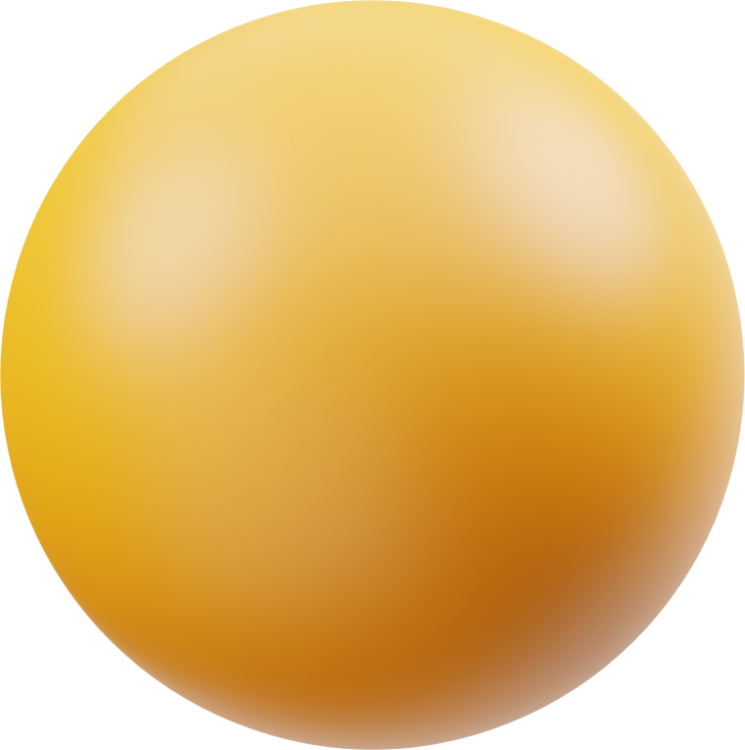
FUNDAMENTALS OF REACT
JSX
CSS or JSS
React
approach
JavaScript and HTML in the same file (JSX)
Embrace functional programming
Components everywhere
Notes:
React encourages developers to adopt a functional programming approach. This means writing clean, predictable, and reusable code through the use of pure functions and immutability. Functional components have become a preferred way of writing React components, leveraging features like hooks to manage state and side effects. This leads to a more modular and testable codebase, reducing the complexity of application logic.

Slide 6
JSX (JAVASCRIPT XML)
JSX is a key feature of React that allows developers to write HTML and JavaScript in the same file. This syntax extension provides a more intuitive and efficient way to build UI components. With JSX, you can easily create and manipulate DOM elements using familiar HTML-like code interwoven with JavaScript functionality. By using JSX, developers get the benefit of a seamless combination of logic and layout, making the code clearer and more manageable.

Slide 7
COMPONENTS EVERYWHERE
React’s architecture revolves around components, which are the building blocks of any React application. Components are reusable, independent pieces of UI that can be composed to build complex interfaces efficiently. Each component manages its own state and logic, promoting a clear separation of concerns. This modular approach not only simplifies development but also enhances maintainability and scalability.
In addition, styling in React can be handled using traditional CSS or by employing JSS (JavaScript Style Sheets), where styles are written in JavaScript. This flexibility allows developers to choose the best styling strategy for their needs.
Notes:
Basically, One of the best things about React is that it makes it easy to create reusable
components that can be used in multiple projects. We'll be taking advantage of this by creating a Todo component that we can use to display each item on our list.

Slide 8
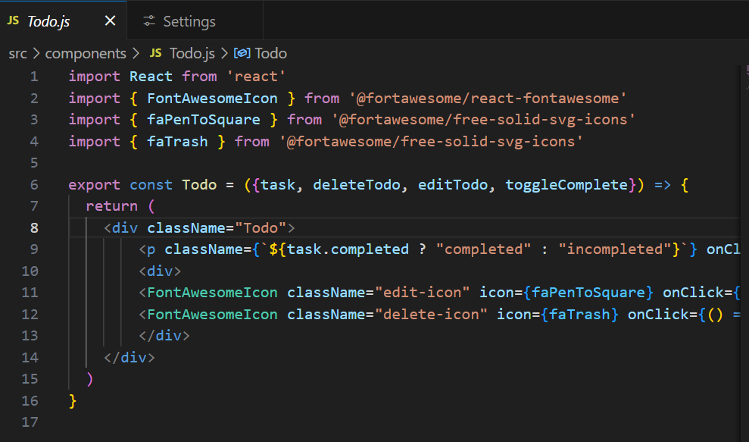
3RD PARTY COMPONENTS AND LIBRARIES
• REACT-ROUTER
• Redux
• Material-UI
• Bootstrap
• Font-Awesome
• SWR

Slide 9
SETTING UP REACT
Create React App (CRA)
File Structure
Easiest way to get started by running:
npx create-react-app my-app.
Typical React app structure: src folder with files like
App.js, index.js.
Run React App
Alternative Setup
For more customization, set up with bundlers like Webpack or use tools like Vite.
In the app directory, run:
npm start
This will start the development server, and your React app should open in your default web browser at http://localhost:3000.

Slide 10
REACT PROPS AND STATE
Props (Properties)
What are Props?
Read-only data passed to components.
Use in Components
Allows data to flow from parent to child components.
State
What is State?
Data managed within a component, affecting its behavior and rendering.
Setting State with useState Hook
Functional components use useState to manage local component state.

Slide 11
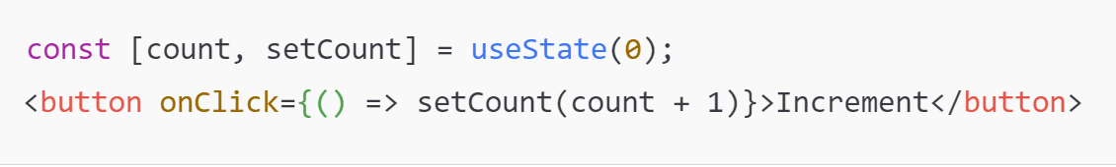
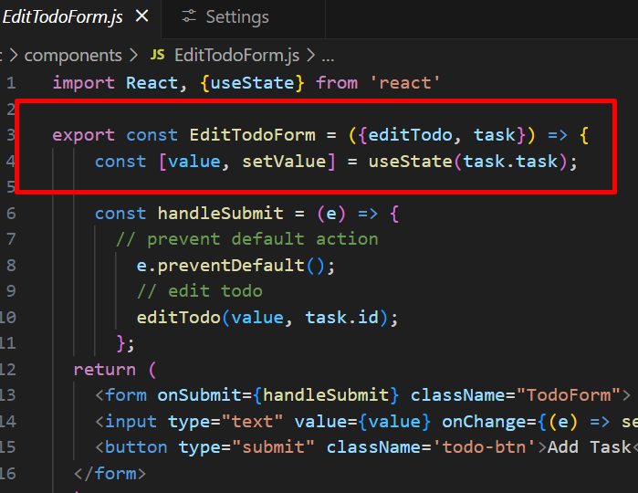
EXAMPLE OF STATE MANAGEMENT WITH USESTATE

Slide 12
REACT HOOKS
What are hooks?
Hooks:
Special functions that allow developers to hook into state and lifecycle of React components.
State: One or more data values associated with a React component instance.
Lifecycle: The events associated with a React component instance
(create, render, destroy, etc).

Slide 13
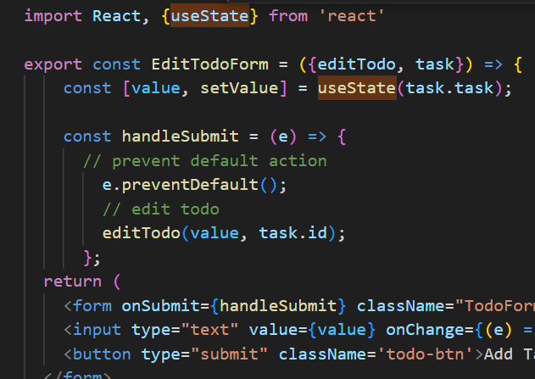
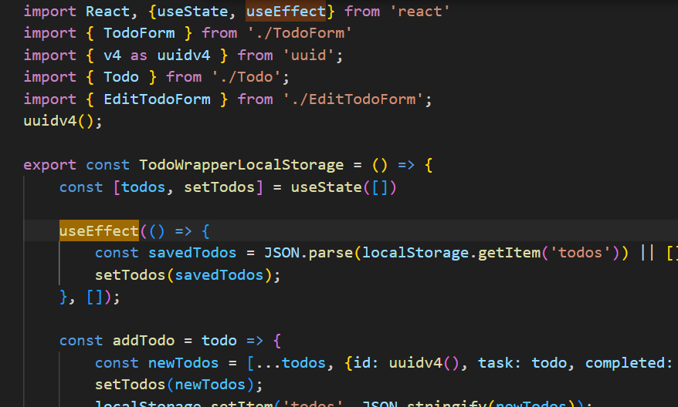
REACT HOOKS
Why Hooks?
Allow the use of state and other React features in functional components, replacing many class component needs.
Main Hooks
useState: Manages local state.
useEffect: Handles side effects and lifecycle events.
useContext: Simplifies context usage in React for prop drilling.
Notes:
First React hook: useState
Purpose:
1. Remember values internally when the component re-renders
2. Tell React to re-render the component when the value changes
A component will only re-render when
1.A value inside props changes
2.A useState setter is called
This means all data values displayed in the HTML should depend on either props or useState
Second React hook: useEffect
Purpose:
Act as an observer, running code in response to value changes

Slide 14
VIRTUAL DOM
The Virtual DOM is a core concept in React that plays a significant role in enhancing the efficiency and performance of web applications. In traditional web development, updating the real DOM (Document Object Model) can be a costly operation, especially when dealing with large or complex UIs. This is because every time the DOM is updated, the browser has to re-calculate styles, layouts, and re-paint the screen, which can be resource-intensive.
Here’s how the process works in detail:
Rendering: When a component's state or props change, React creates a Virtual DOM tree. This is a JavaScript object that represents the UI elements.
Diffing: React compares the new Virtual DOM with the previous Virtual DOM to determine what has changed. This comparison is highly efficient, thanks to algorithms like the "reconciliation" algorithm.
Updating: Once React identifies the differences, it updates only the changed elements in the real DOM. This results in faster and more efficient updates.

Slide 15
CONCLUSION
The future of React:
React’s future emphasizes performance and developer experience. React Server Components (RSC) will render components on the server, boosting load times and SEO.
Concurrent Mode aims to improve responsiveness by prioritizing user interactions and handling asynchronous updates efficiently. Focus on Static Site Generation (SSG) and Server-Side Rendering (SSR), especially with frameworks like Next.js, is growing for faster, SEO-optimized apps. React also aims to improve developer tools, TypeScript support, and state management with refined libraries like Redux. These advancements keep React at the forefront of building efficient, scalable web applications.

Slide 16
Design of multi-tier Internet applications SPEC: Web technologies engineering
THANK YOU
for your time and attention
Present by Zhe Chen

